Slide 1
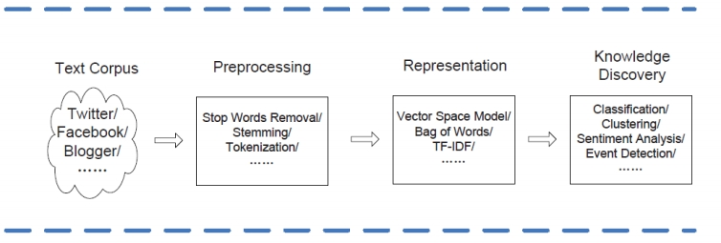
A General Framework for Text Analytics
❐
A traditional text analytics framework consists of three consecutive phases: Text Preprocessing, Text Representation and Knowledge Discovery, shown in Figure below.
Figure 1. A Traditional Framework for Text Analytics ()

Slide 2
A General Framework for Text Analytics
❐
Text Preprocessing
Text preprocessing aims to make the input documents more consistent to facilitate text representation, which is necessary for most text analytics tasks. The text data is usually preprocessed to remove parts that do not bring any relevant information.
❐
Text Representation
After text preprocessing has been completed, the individual word tokens must be transformed into a vector representation suitable for input into text mining algorithms.
❐
Knowledge Discovery
When we successfully transform the text corpus into numeric vectors, we can apply the existing machine learning or data mining methods like classification or clustering.
By conducting text preprocessing, text representation and knowledge discovery methods, we can mine latent, useful information from the input text corpus, like similarity between two messages from social media.

Slide 3
Text Preprocessing
❐
The possible steps of text preprocessing are the same for all text mining tasks, though which processing steps are chosen depends on the task. The ways to process documents are so varied and application- and language-dependent. The basic steps are as follows:
1.
Choose the scope of the text to be processed (documents, paragraphs, etc.). Choosing the proper scope depends on the goals of the text mining task: for classification or clustering tasks, often the entire document is the proper scope; for sentiment analysis, document summarization, or information retrieval, smaller units of text such as paragraphs or sections might be more appropriate.
2.
Tokenize: Break text into discrete words called tokens → Transform text into a list of words (tokens).
3.
Remove stopwords (“stopping”): remove all the stopwords, that is, all the words used to construct the syntax of a sentence but not containing text information (such as conjunctions, articles, and prepositions) such as a, about, an, are, as, at, be, by, for, from, how, will, with, and many others.

Slide 4
Text Preprocessing
4.
Stem: Remove prefixes and suffixes to normalize words - for example, run, running, and runs would all be stemmed to run. So the words with variant forms can be regarded as same feature. Many algorithms have been invented to do stemming (Porter, Snowball, and Lancaster). It also depends on the language. Notice that lemmatization can be used instead stemming, it depends on the text mining subtasks and corpus language.
5.
Normalize spelling: Unify misspellings and other spelling variations into a single token.
6.
Detect sentence boundaries: Mark the ends of sentences.
7.
Normalize case: Convert the text to either all lower or all upper case.

Slide 5
Text Preprocessing
Difference between Stemming and Lemmatization
❐
Stemming and lemmatization both of these concepts are used to normalize the given word by removing infixes and consider its meaning. The major difference between these is as shown:
■ Stemming:
1. Stemming usually operates on single word without knowledge of the context.
2. In stemming, we do not consider POS (Part-of-speech) tags.
3.
Stemming is used to group words with a similar basic meaning together. Lemmatization :
■
1.
Lemmatization usually considers words and the context of the word in the sentence.
2.
In lemmatization, we consider POS tags.

Slide 6
Text Preprocessing
❐
Preprocessing methods depend on specific application. In many applications, such as Opinion Mining or Natural Language Processing (NLP), they need to analyze the message from a syntactical point of view, which requires that the method retains the original sentence structure. Without this information, it is difficult to distinguish “Which university did the president graduate from?” and “Which president is a graduate of Harvard University?”, which have overlapping vocabularies. In this case, we need to avoid removing the syntax-containing words.

Slide 7
Text Representation: Bag of Words and Vector Space Models
The most popular structured representation of text is the vector-space model, which represents every document (text) from the corpus as a vector whose length is equal to the vocabulary of the corpus. This results in an extremely high-dimensional space; typically, every distinct string of characters occurring in the collection of text documents has a dimension. This includes dimensions for common English words and other strings such as email addresses and URLs. For a collection of text documents of reasonable size, the vectors can easily contain hundreds of thousands of elements. For those readers who are familiar with data mining or machine learning, the vector-space model can be viewed as a traditional feature vector where words and strings substitute for more traditional numerical features. Therefore, it is not surprising that many text mining solutions consist of applying data mining or machine learning algorithms to text stored in a vector-space representation, provided these algorithms can be adapted or extended to deal efficiently with the large dimensional space encountered in text situations.

Slide 8
Text Representation: Bag of Words and Vector Space Models
The vector-space model makes an implicit assumption (called the bag-of words assumption) that the order of the words in the document does not matter. This may seem like a big assumption, since text must be read in a specific order to be understood. For many text mining tasks, such as document classification or clustering, however, this assumption is usually not a problem. The collection of words appearing in the document (in any order) is usually sufficient to differentiate between semantic concepts. The main strength of text mining algorithms is their ability to use all of the words in the document-primary keywords and the remaining general text. Often, keywords alone do not differentiate a document, but instead the usage patterns of the secondary words provide the differentiating characteristics.
Though the bag-of-words assumption works well for many tasks, it is not a universal solution. For some tasks, such as information extraction and natural language processing, the order of words is critical for solving the task successfully. Prominent features in both entity extraction and natural language processing include both preceding and following words and the decision (e.g., the part of speech) for those words. Specialized algorithms and models for handling sequences such as finite state machines or conditional random fields are used in these cases.
Another challenge for using the vector-space model is the presence of homographs. These are words that are spelled the same but have different meanings.
P.S. Bag of Words model is also known as Vector Space Model.

Slide 9
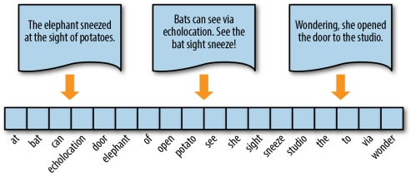
Understanding BOW
Bag of words (BOW) model represents the text as the bag or multiset of its words, disregarding grammar and word order and just keeping words (after text preprocessing has been completed). BOW is often used to generate features; after generating BOW, we can derive the term-frequency of each word in the document, which can later be fed to a machine learning algorithm.
To vectorize a corpus with a bag-of-words (BOW) approach, we represent every document from the corpus as a vector whose length is equal to the vocabulary of the corpus. We can simplify the computation by sorting token positions of the vector into alphabetical order, as shown in the following Figure. Alternatively, we can keep a dictionary that maps tokens to vector positions. Either way, we arrive at a vector mapping of the corpus that enables us to uniquely represent every document.
Figure 2. Encoding documents as vectors (Tony Ojeda et al., 2018)

Slide 10
Understanding BOW
What should each element in the document vector be? In the next sections, We will explore three types of vector encoding :
- Frequency vector,
- One-hot vector (a binary representation),
-
TF–IDF vector (a float-valued weighted vector).
There are many available APIs (such as Scikit-Learn, Gensim, and NLTK) that make the implementations of those vectors encoding easier.

Slide 11
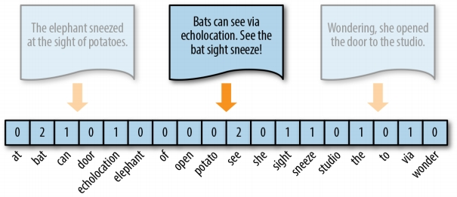
Frequency vector
❐
In this representation, each document is represented by one vector where a vector element i represents the number of times (frequency) the i word appears in the document. This representation can either be a straight count (integer) encoding as shown in the following figure or a normalized encoding where each word is weighted by the total number of words in the document.
th
Figure 3. Token frequency as vector encoding (Tony Ojeda et al., 2018)

Slide 12
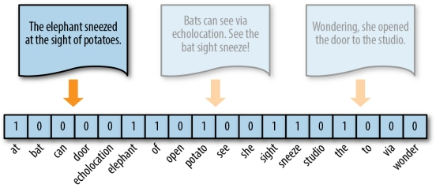
One-hot encoding
Because they disregard grammar and the relative position of words in documents, frequency-based encoding methods suffer from the long tail, or Zipfian distribution, that characterizes natural language. As a result, tokens that occur very frequently are orders of magnitude more “significant” than other, less frequent ones. This can have a significant impact on some models (e.g., generalized linear models) that expect normally distributed features.
A solution to this problem is one-hot encoding, a boolean vector encoding method that marks a particular vector index with a value of true (1) if the token exists in the document and false (0) if it does not. In other words, each element of a one-hot encoded vector reflects either the presence or absence of the token in the described text as shown in the following Figure.
Figure 4. One-hot encoding (Tony Ojeda et al., 2018)

Slide 13
One-hot encoding
❐
One-hot encoding is very useful. Some of the basic applications for one-hot encoding format are:
■ Many artificial neural networks accept input data in the one-hot encoding format and generate output vectors that carry the sematic representation as well.
■ The word2vec algorithm accepts input data in the form of words and these words are in the form of vectors that are generated by one-hot encoding.
■
…..

Slide 14
TF-IDF
❐
Storing text as weighted vectors first requires choosing a weighting scheme. The most popular scheme is the TF-IDF weighting approach.
❐
The concept TF-IDF stands for term frequency-inverse document frequency. This is in the field of numerical statistics. With this concept, we will be able to decide how important a word is to a given document in the present dataset or corpus (collection).

Slide 15
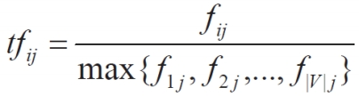
TF-IDF
❐
Term Frequency (TF):
The term frequency for a term ti in document dj is the number of times that ti appears in document dj, denoted by fij. It can be absolute or relative (normalization may also be applied).
The normalized term frequency (denoted by tfij) of ti in dj is given by the equation below:
where the maximum is computed over all terms that appear in document dj. If term ti does not appear in dj then tfij = 0.
|V| : is the vocabulary size of the collection (v words).

Slide 16

TF-IDF
❐
Document Frequency (DF)
■
dfi = document frequency of term ti
= number of documents containing term ti
The inverse document frequency (denoted by idfi 
) of term ti
is given by:
- Where N: total number of documents
- There is one IDF value for each term ti in a collection.
- Log used to dampen the effect relative to tf.
The intuition here is that if a term appears in a large number of documents in the collection, it is probably not important or not discriminative.

Slide 17

TF-IDF
❐
The final TF-IDF term weight is given by:
Postscript:
TF-IDF (ti,dj) =
tf-idf weighting has
many variants. Here
we only gave the
most basic one.
❐
The assumption behind TF-IDF is that words with high term frequency should receive high weight unless they also have high document frequency. The word “the” is one of the most commonly occurring words in the English language. “The” often occurs many times within a single document, but it also occurs in nearly every document. These two competing effects cancel out to give “the” a low weight.

Slide 18
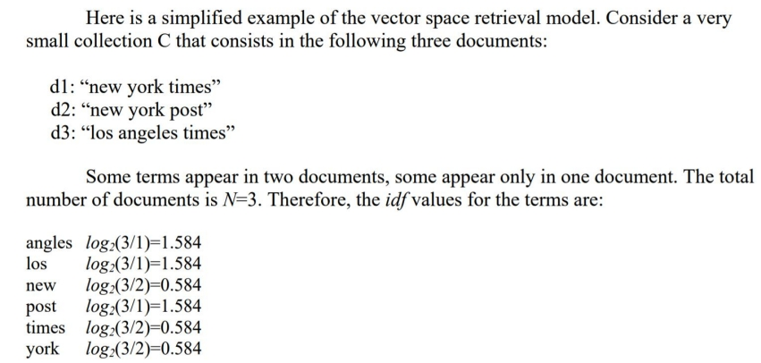
3.6.2 Computing TF-IDF: An Example

Slide 19
3.6.3 TF-IDF based applications Some applications that use TF-IDF:
❐
In general, text data analysis can be performed by TF-IDF easily. You can get information about the most accurate keywords for your dataset.
❐
If you are developing a text summarization application where you have a selected statistical approach, then TF-IDF is the most important feature for generating a summary for the document.
❐
Variations of the TF-IDF weighting scheme are often used by search engines to find out the scoring and ranking of a document's relevance for a given user query. Document classification applications.
❐

